Slide 1



Integrate with ONDC
Microsoft Shopping and M365 Growth Teams
Notes:
Hi everyone, I am excited to be here today to talk to you! Let's get started!

Slide 2
Contents
Introduction
What have we done?
Prototype
Logs (Proofs)
Future work
Vote of Thanks
Notes:
Roadmap Overview: 10 min Bo
FR: 15 min Neta
Speech: 15 min Heiko
Translator: 15 min Krishna

Slide 3



A
Introduction
G
E
Microsoft Shopping Team
N
Microsoft M365 Growth Team
D
We have enabled shopping on Bing.com across 20+ markets and shopping on Edge browser with more than a million shoppers coming on our platform to shop daily
A

Slide 4
A
What have we done?
G
M365 Growth Team worked on the seller side application (SMB cloud service) enabling retailers to get onboarded on ONDC network.
E
N
Shopping team has integrated the buyer side app with ONDC network.
D
Shopping team has integrated the buyer side app with ONDC network.
A

Slide 5








Quesadillas
Bing Shopping (Buyer Platform)
Open APIs
Open N/w Interfaces for e-commerce
Microsoft Cloud (Seller/SMB cloud service)
Annapurna Groceries
Rajadhani Foods

Slide 6
Flow: Buyer Side
Search
Select
Init
Payment

Slide 7
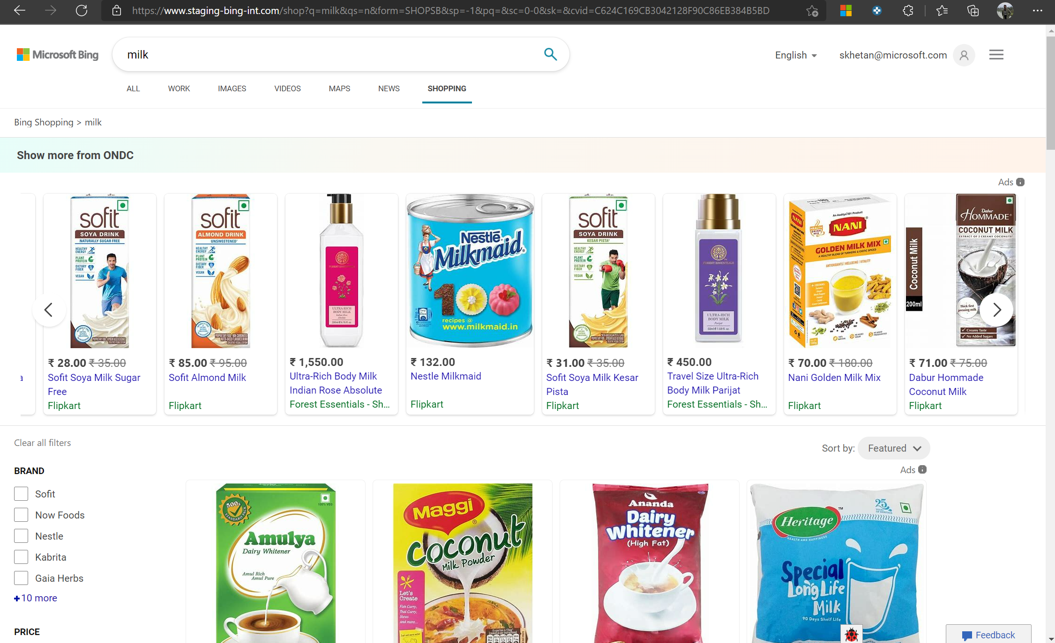
Search
Select
Init
Payment
Buyer goes to the shopping tab within Bing and clicks on ‘Show more from ONDC’

Slide 8
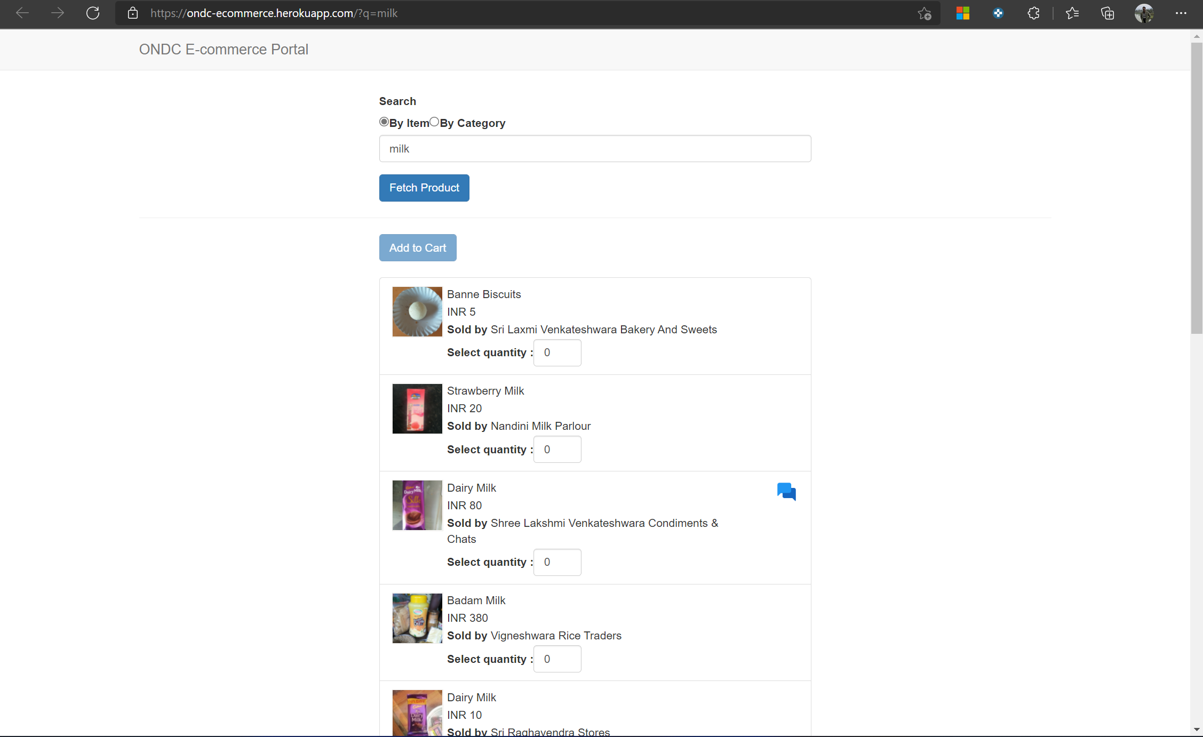
Search
Select
Init
Payment
Buyer can search by item or by category

Slide 9
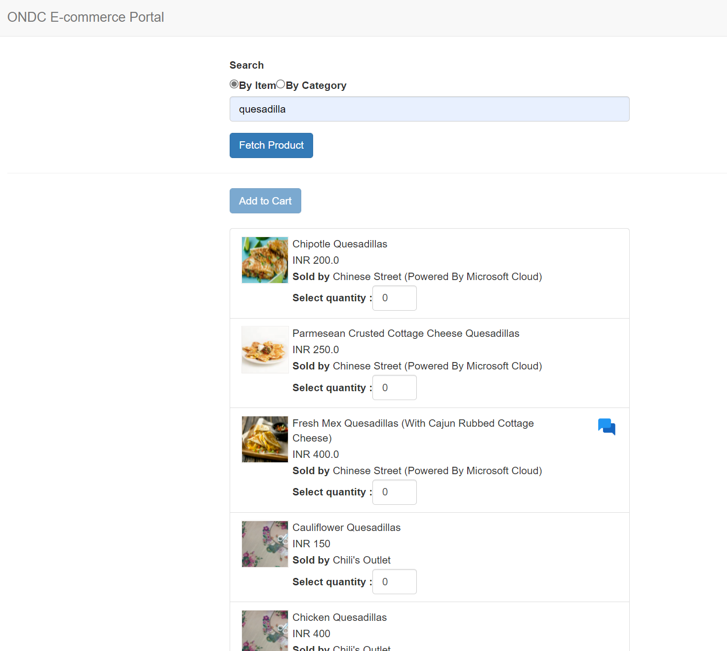
Search
Select
Init
Payment
Buyer searches for ‘Quesadilla’ and gets results from multiple nearby sellers; some of whom are enabled by Microsoft Cloud (Seller side App)
Buyer can chat with Microsoft enabled Sellers in their language of choice

Slide 10
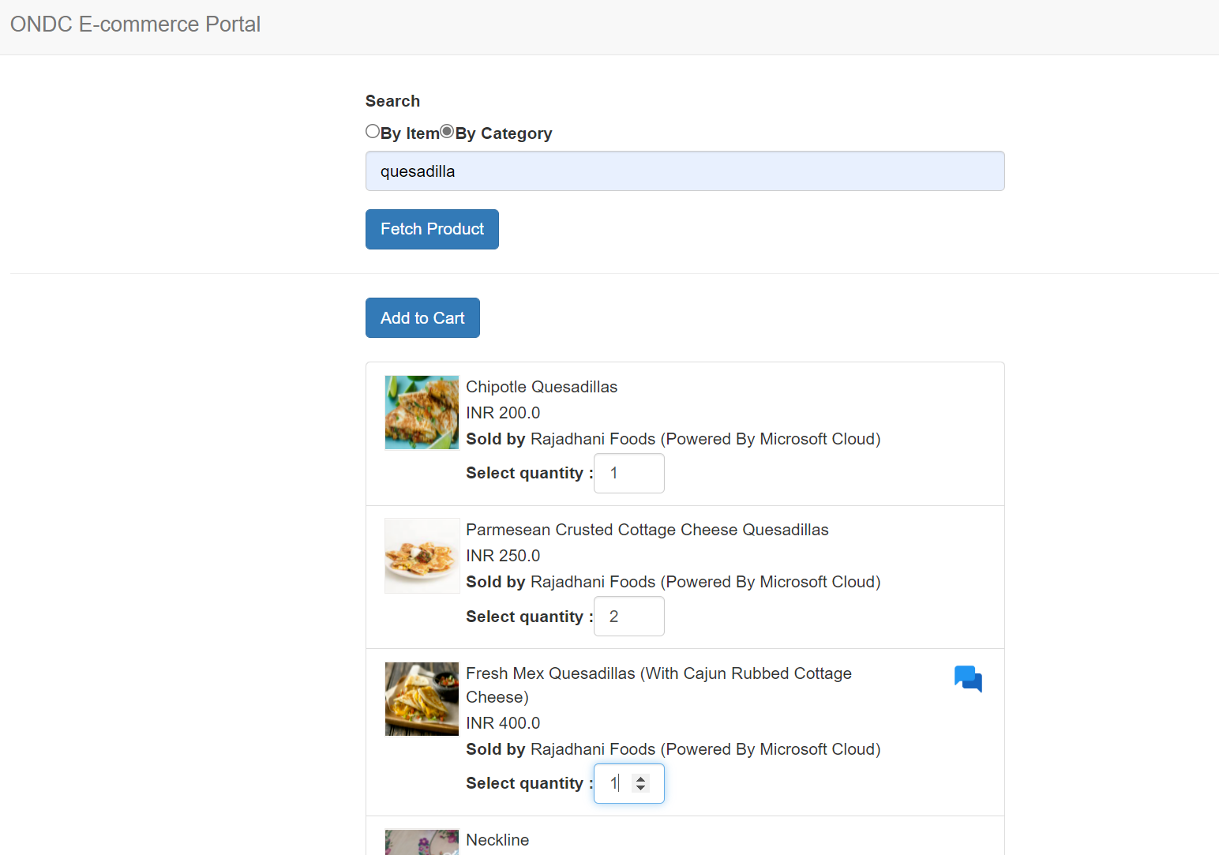
Search
Select
Init
Payment
Buyer Adds items to the cart

Slide 11
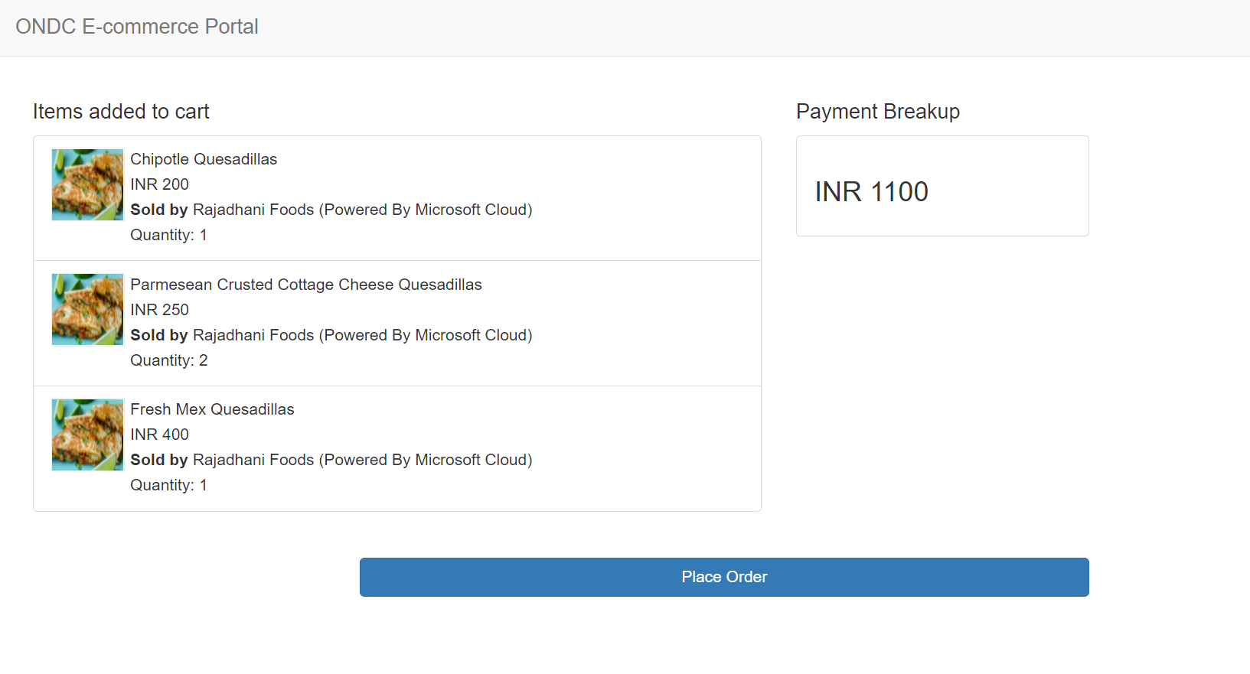
Search
Select
Init
Payment
The items added to the cart can be seen along with the total Amount

Slide 12
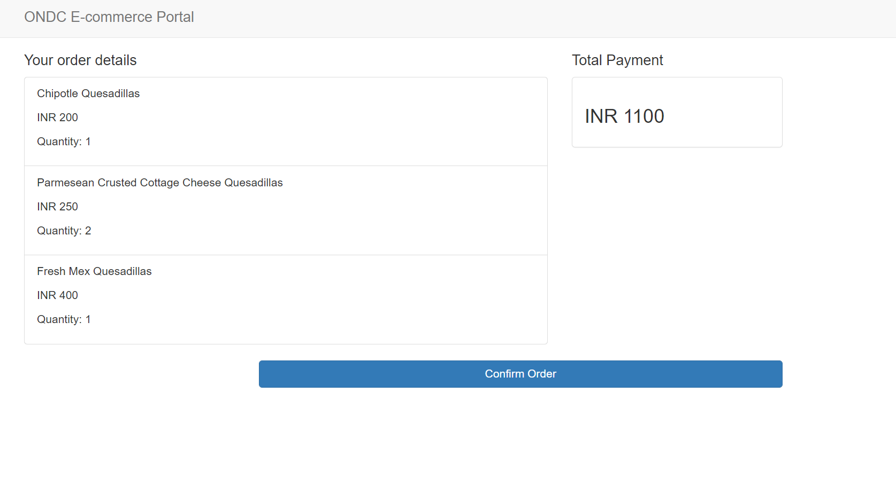
Search
Select
Init
Payment
The buyer places the order by choosing the payment option (CoD)

Slide 13
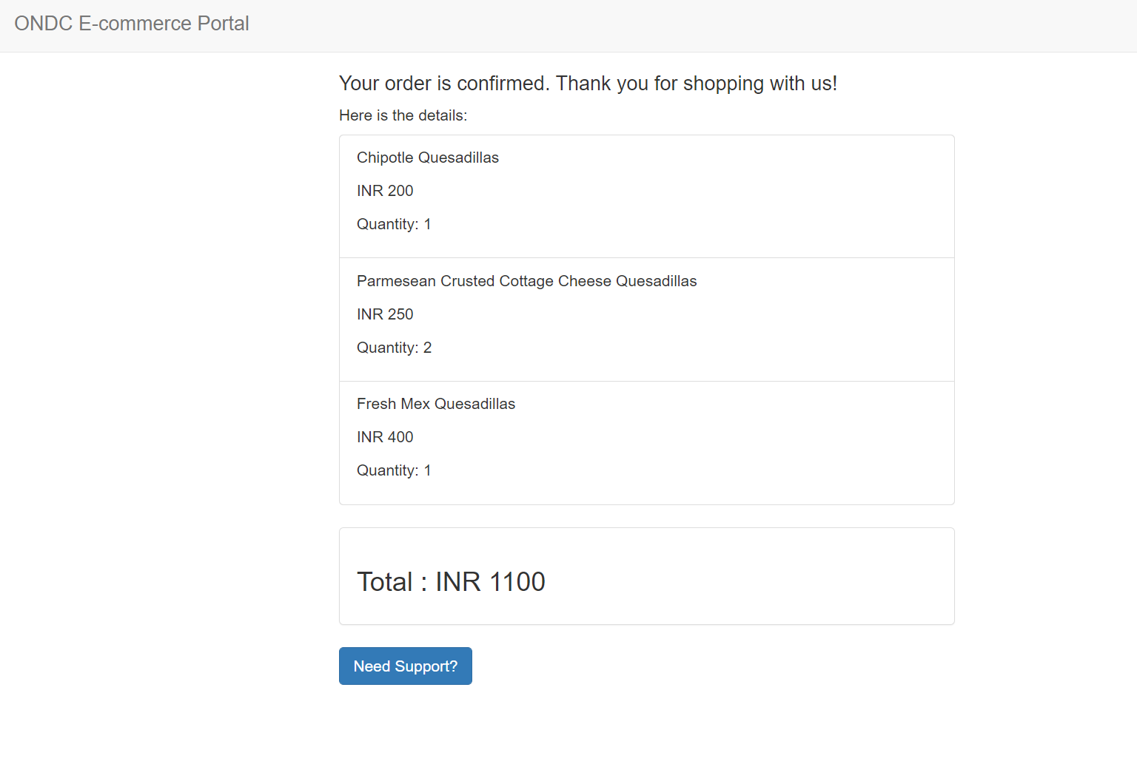
Search
Select
Init
Payment
The buyer makes the payment (Cash on Delivery) and gets the confirmation
The buyer can also use the support button in case they need any help

Slide 14
Request/Response Logs (Proofs)
Search
Select
Init
Confirm
Support

Slide 15
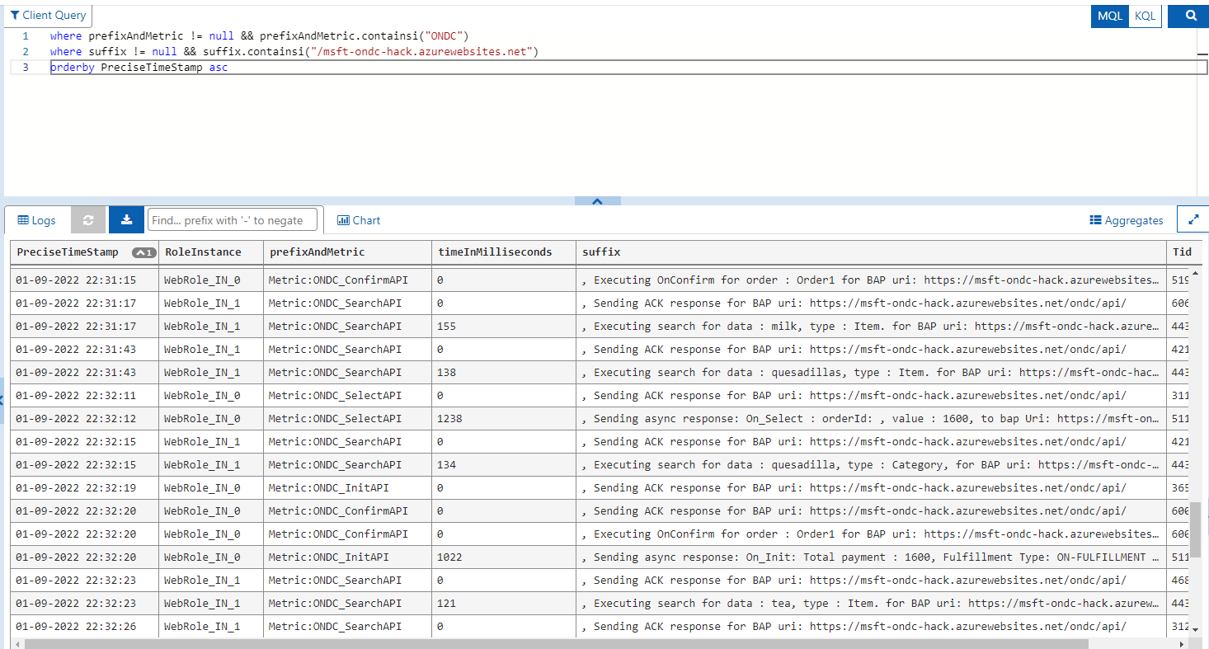
Requests with Bing BAP

Slide 16
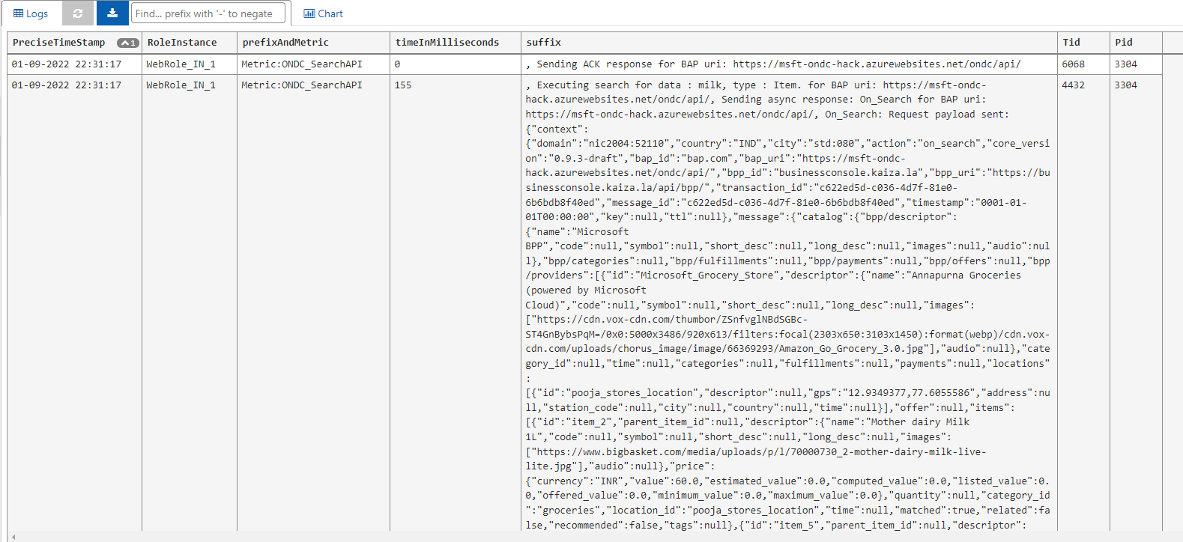
Search

Slide 17
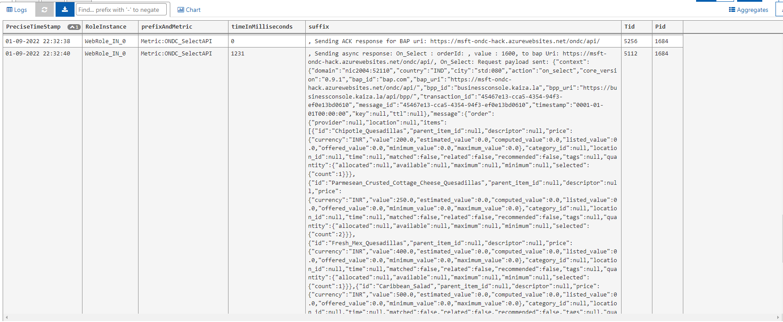
Select

Slide 18
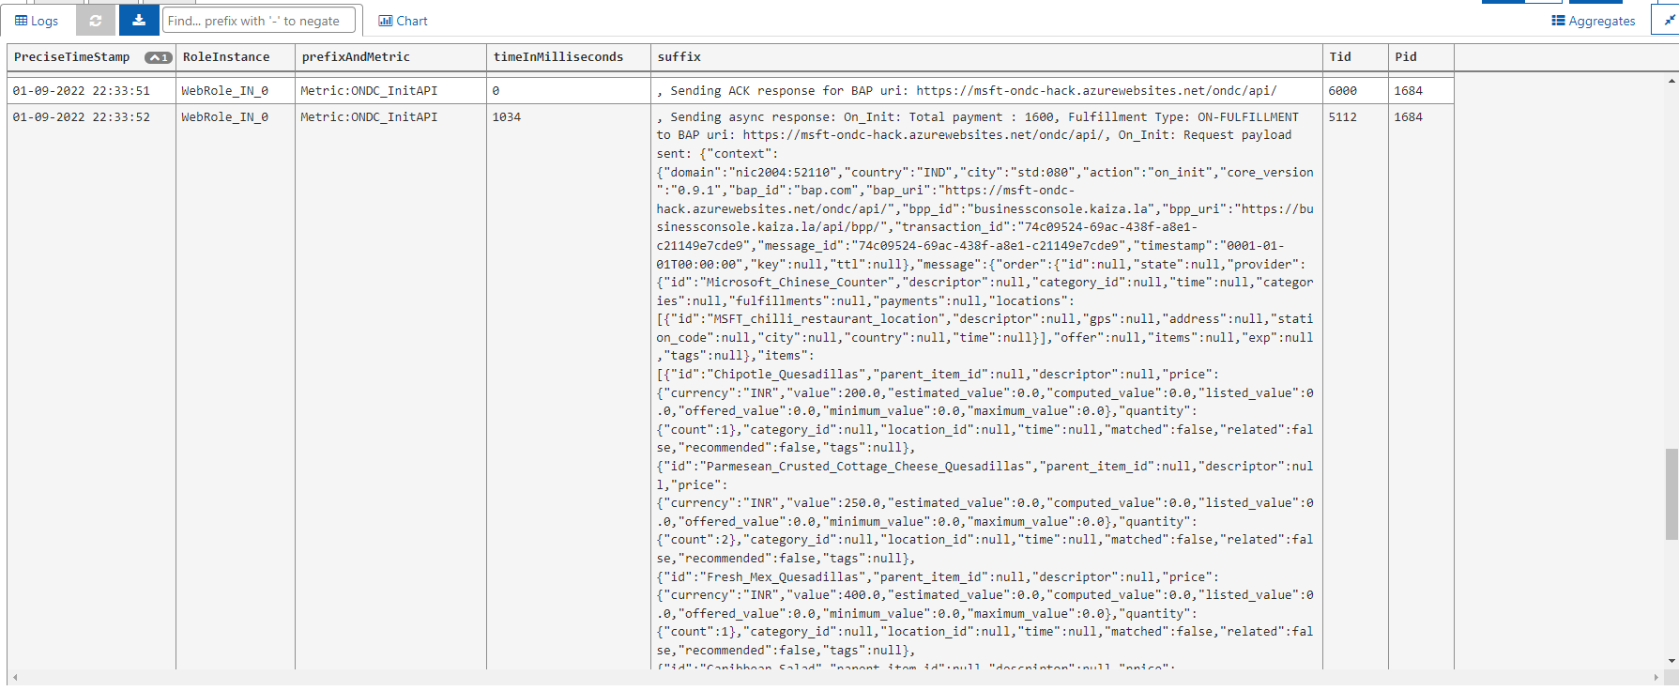
Init

Slide 19
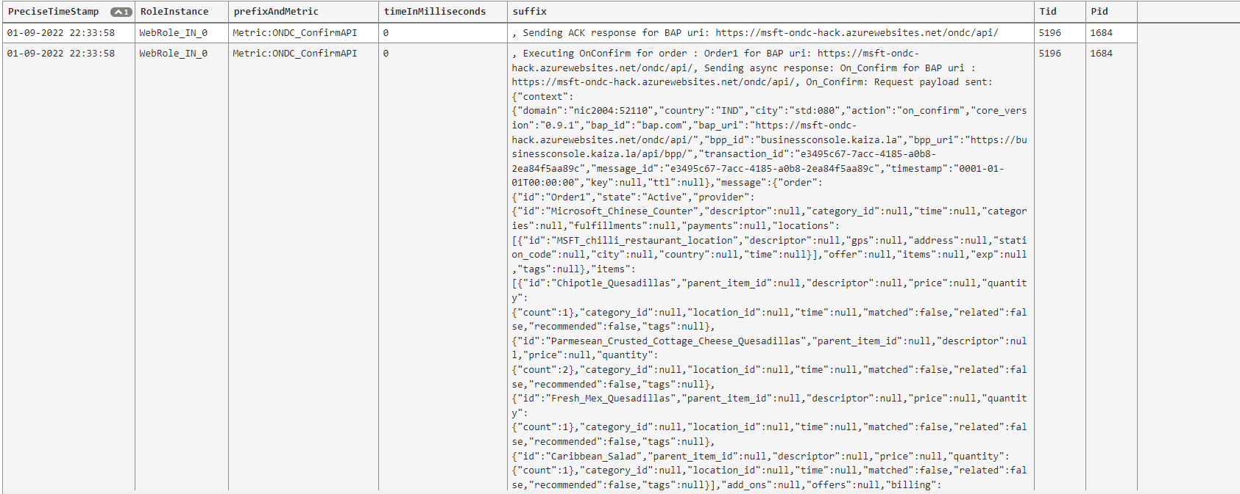
Confirm

Slide 20
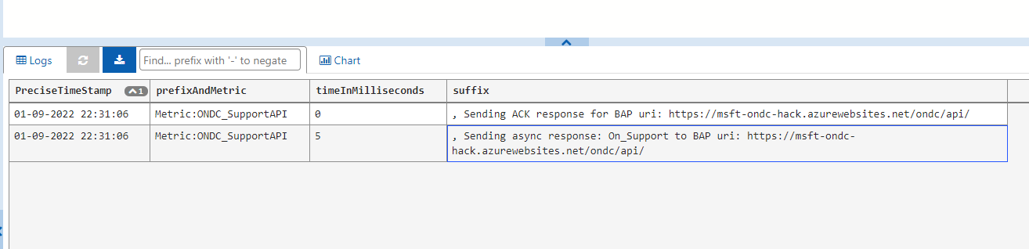
Support

Slide 21
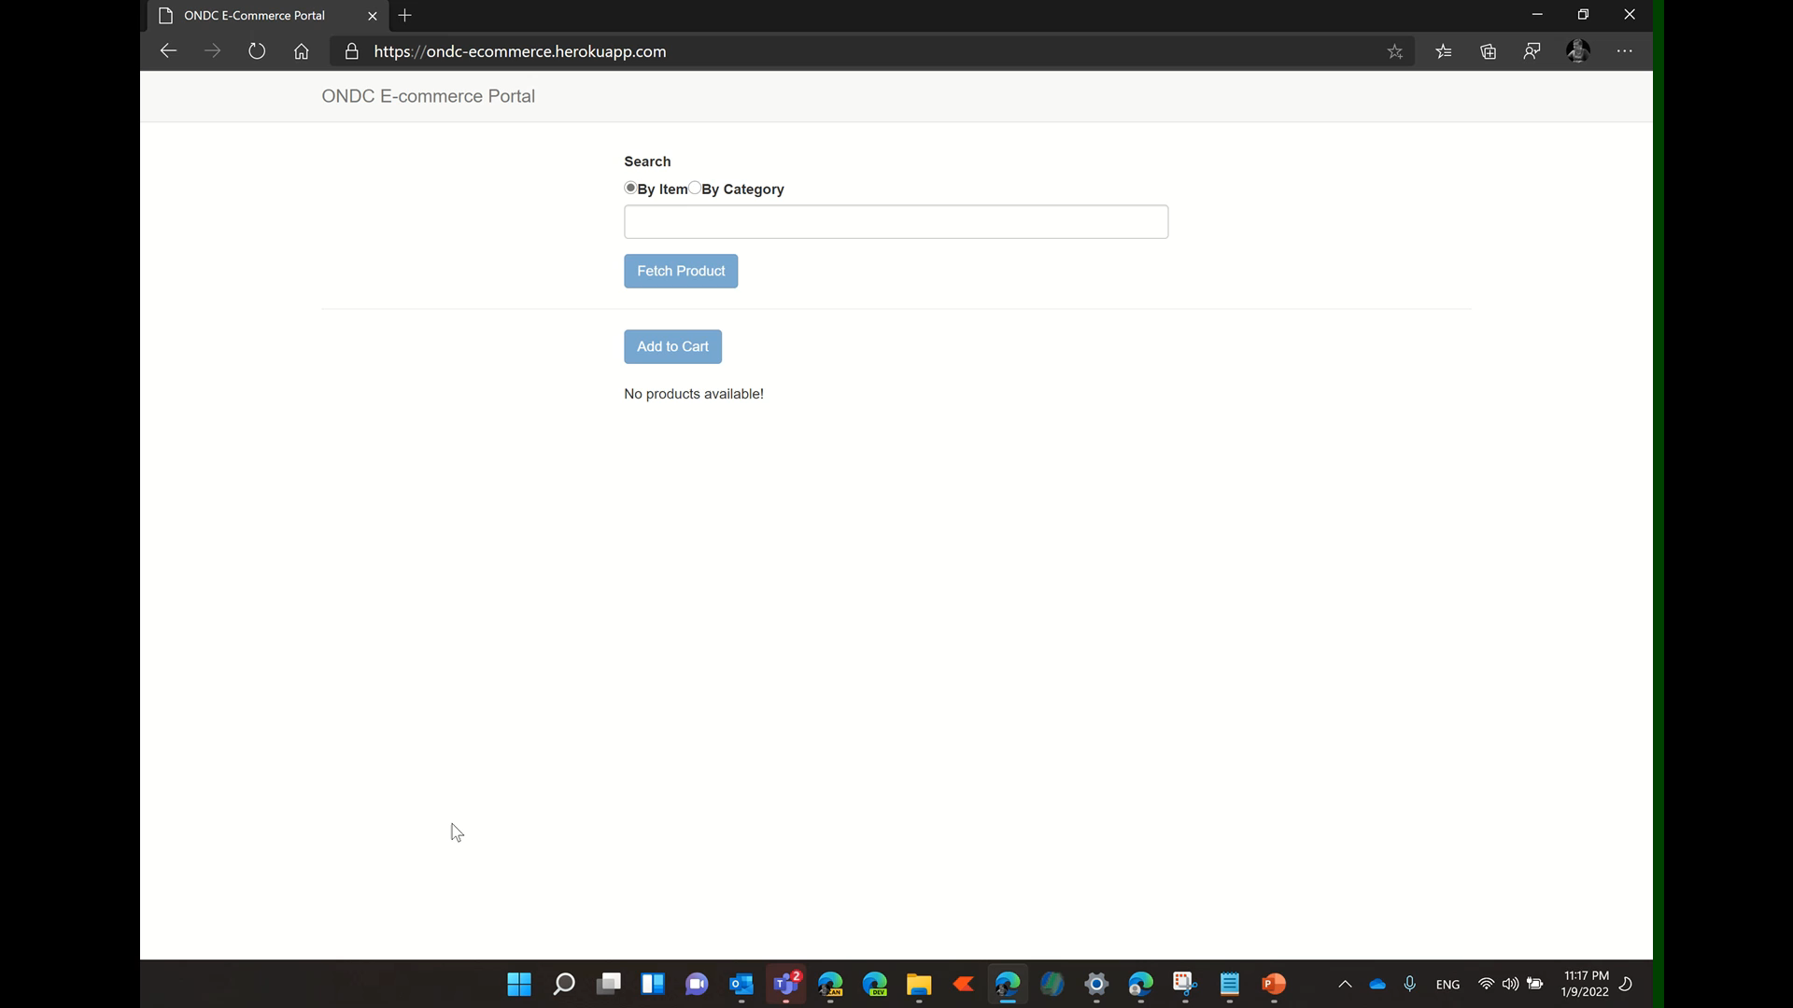

Slide 22
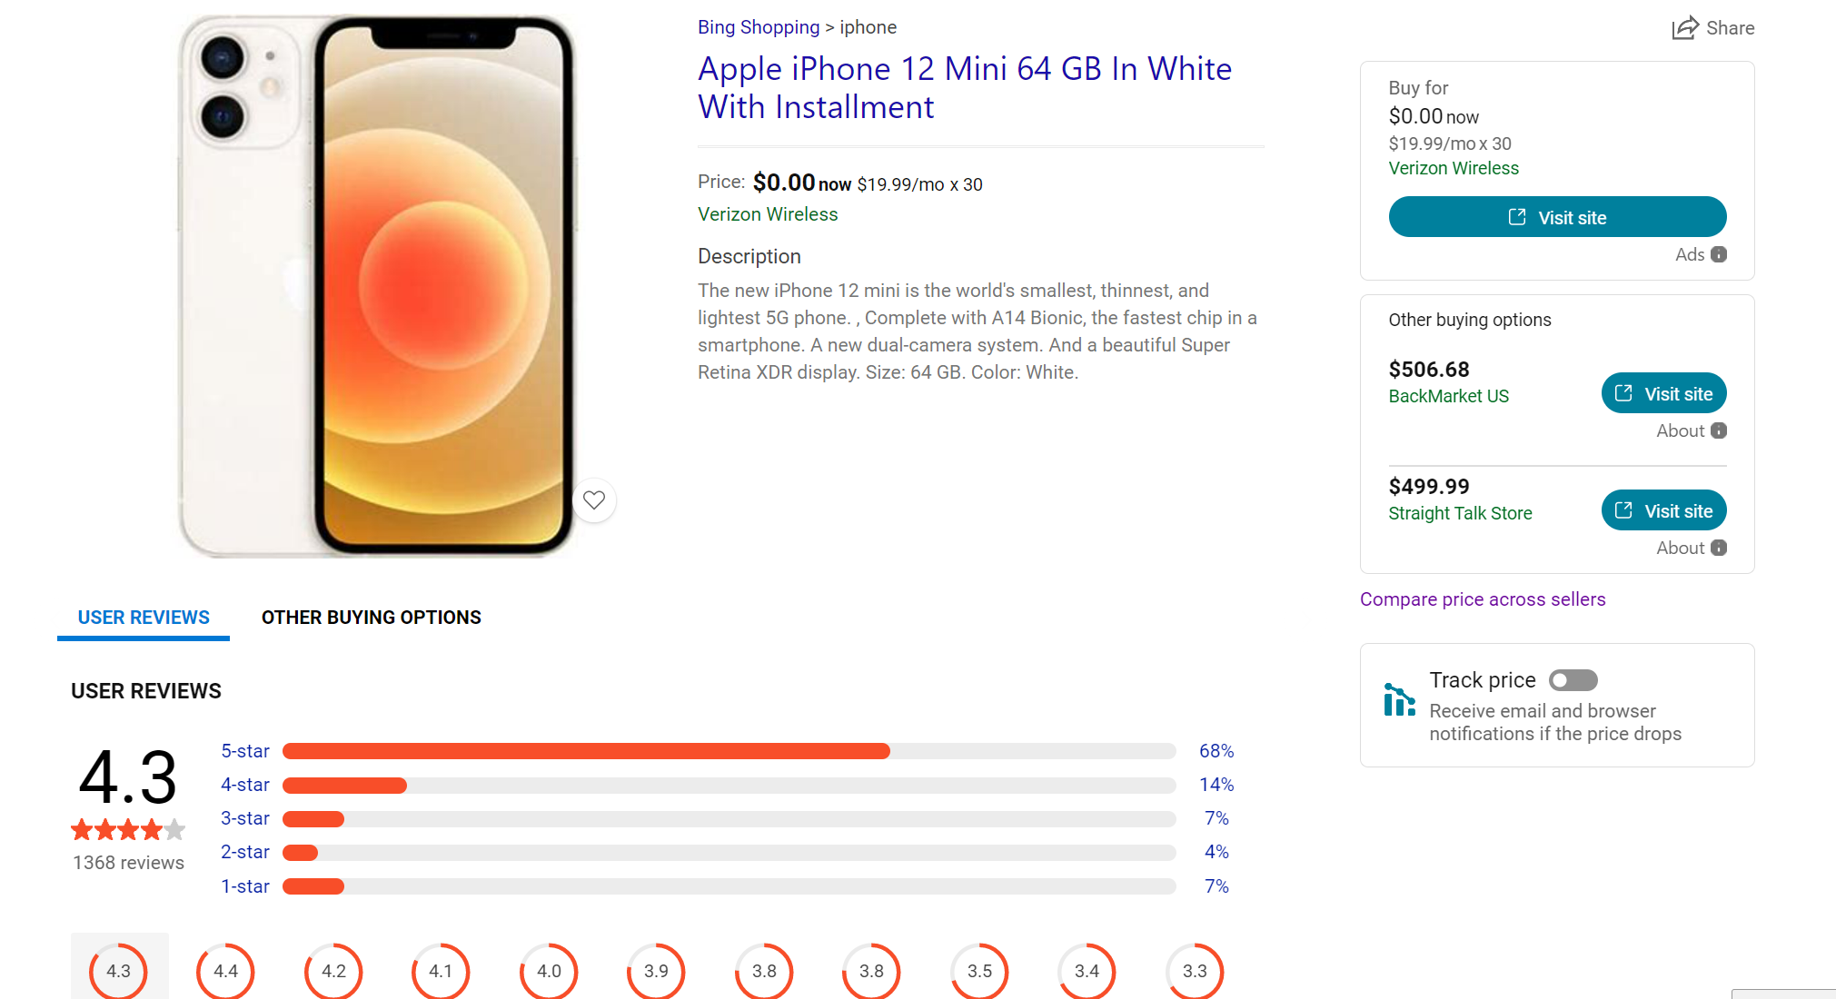
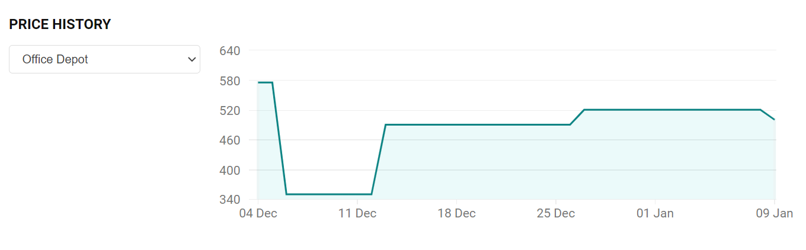
A
Future Work
G
Integrate with payments and logistics providers
E
Add Chat feature to enable buyers to chat with the seller (powered by MS Teams) before, during or after purchase
N
Conflate the same product from multiple sellers to enable buyer to compare product price, delivery price, etc.
D
A
Show price History for products coming from ONDC network

Slide 23
Thanks
Thanks to the ONDC organizing Team (Koshy, Sujith, Supriyo and Team) and the entire ONDC committee who supported one another for greater good across India

